Slide 1
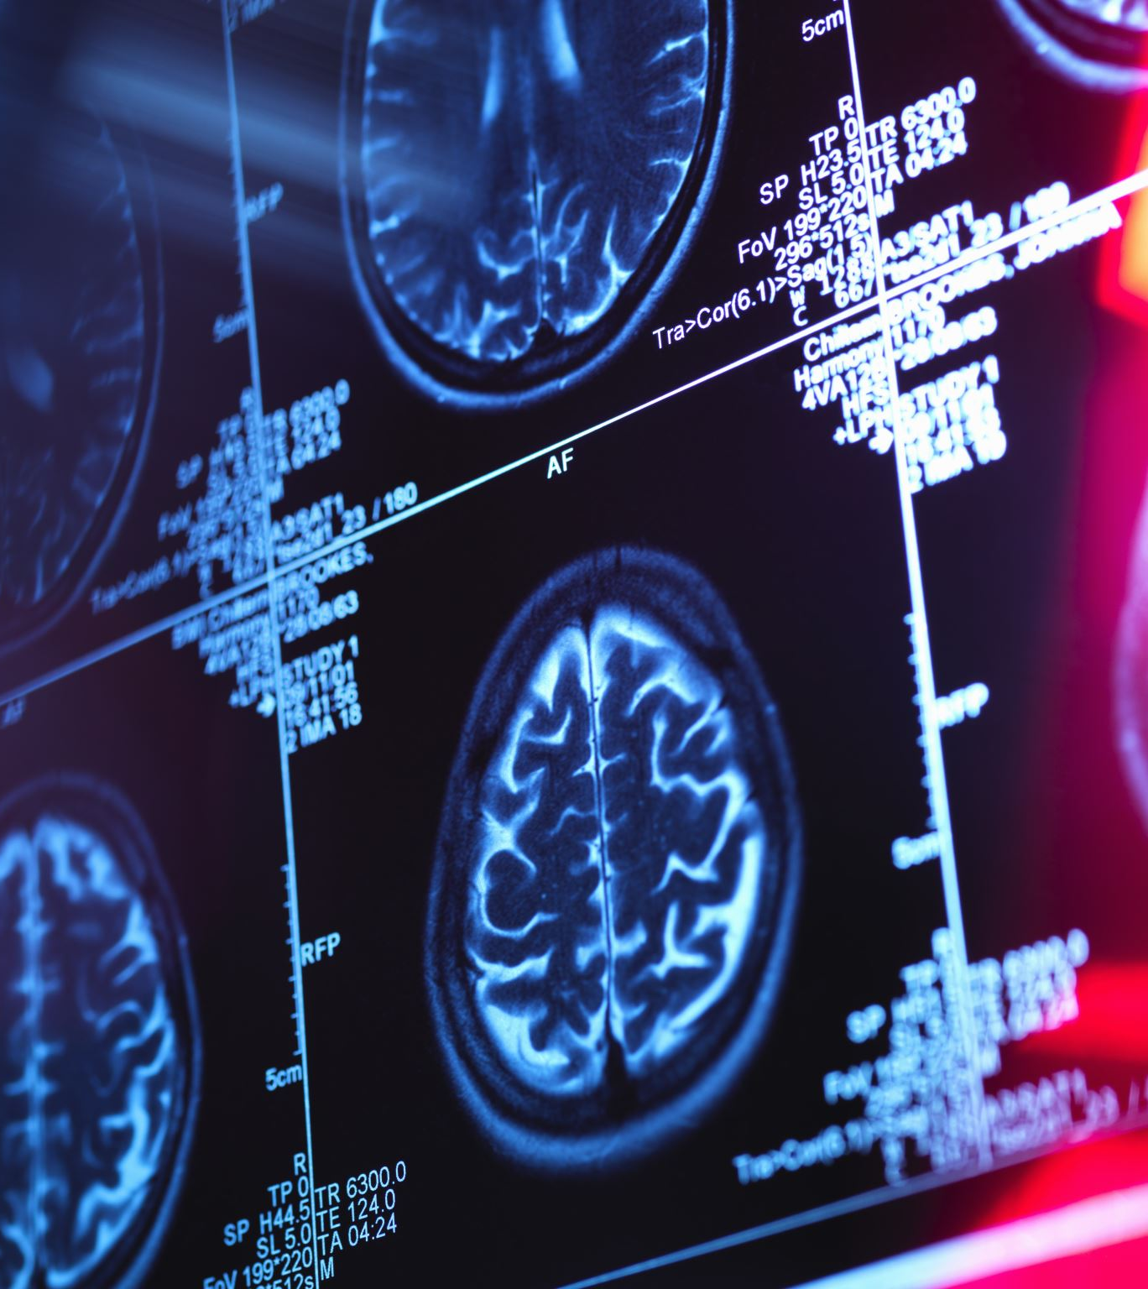
Healthwise AI
An AI-Powered Patient Health Companion (PHC) & Your Personalized Health Compass/Navigator
By Colette O. Obazee
https://github.com/ksu-hmi/Healthwise_AI

